Slide 1

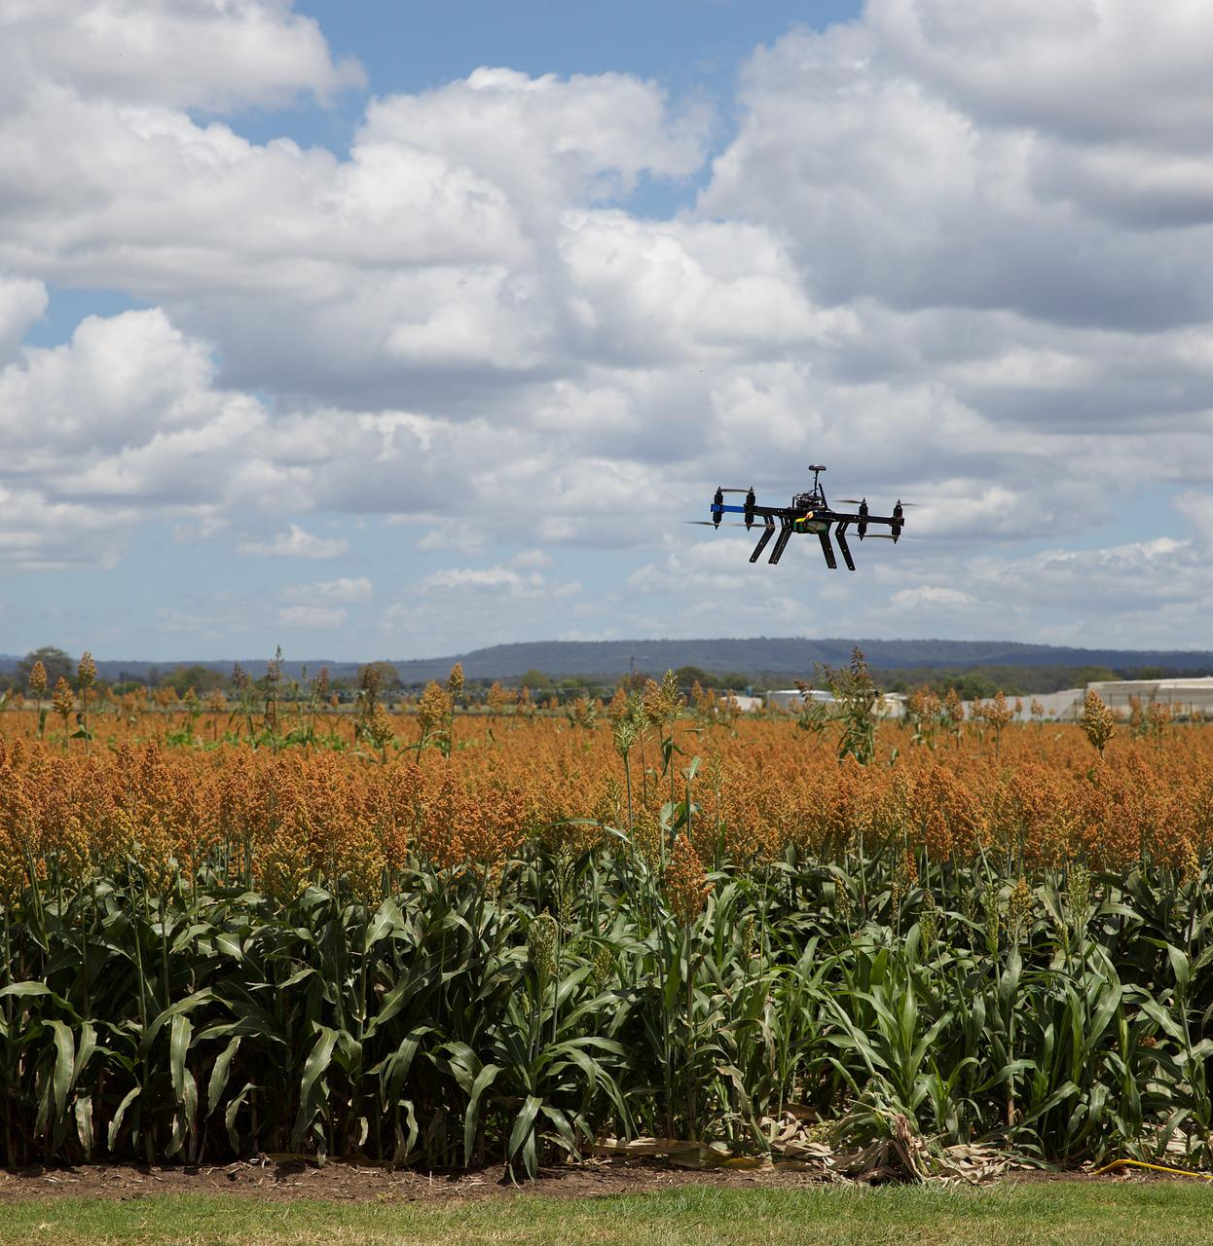
Precision Farming Using Autonomous Vehicle
Group A1:
Jaouaher Belgacem Jasmeet matta
Arsany Grigis
[1]
Notes:
Line spacing + Page numbers

Slide 2
The Software Modelling

Slide 3
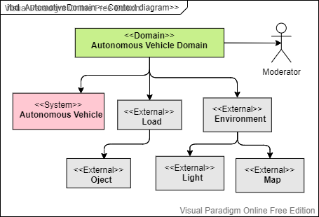
Context Diagram

Slide 4
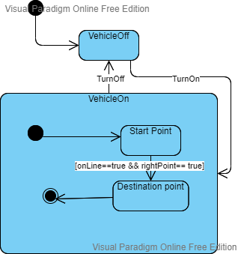
State MachineDiagram

Slide 5
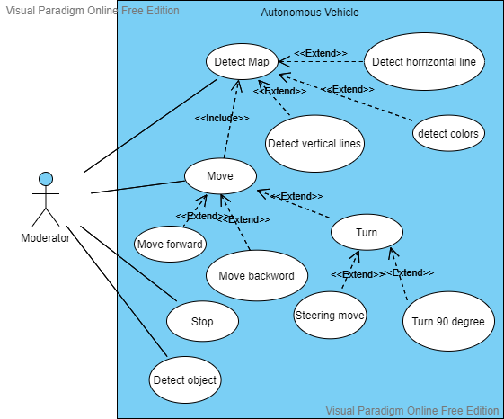
Use Case Diagram

Slide 6
The Hardware Modelling

Slide 7

Design Inspiration
[1]

Slide 8
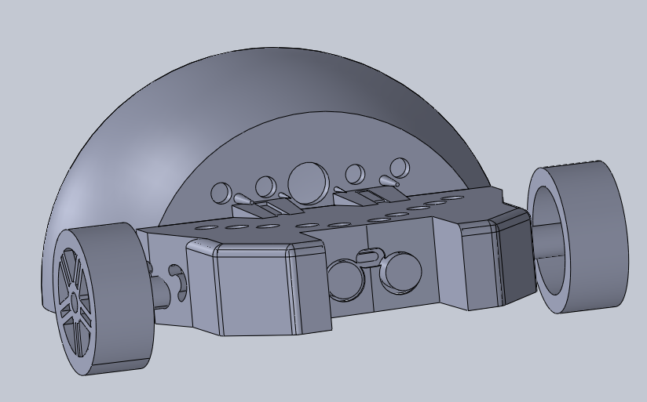
Final Design

Slide 9
Code Implemetation

Slide 10
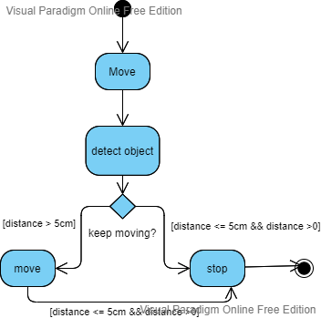
Object Detection

Slide 11
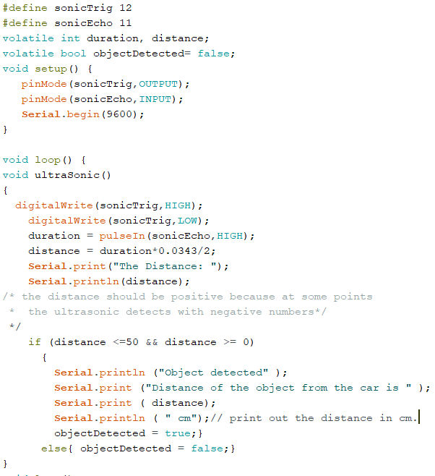
Object Detection

Slide 12
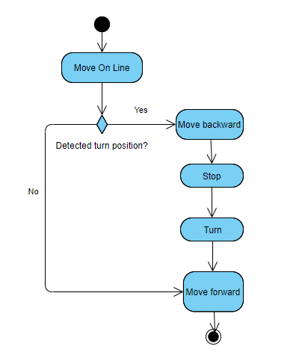
90-Degree Turn

Slide 13
Sources
1: pixabay.com

Slide 14
THANK YOU FOR YOUR ATTENTION

